Slide 1

Computer Architecture
CS-211
Spring 2017 | Recitation
Abu Shoeb

Slide 2
Agenda
Programming Assignment 3 (Binary Bomb Lab)
Overview
How to defuse the bomb using GDB!
Some useful resources
Assembly Language

Slide 3
PA 3 – Bomb Lab
Download bomb<N>.tar (N represents your ID )
http://airavat.cs.rutgers.edu:17200
Don’t download more than 2 bombs!
Download this in iLab machines or copy downloaded bomb into iLab machines
Untar your bomb
$ tar -xvf bomb<N>
bomb<N> directory will have
bomb, bomb.c, README
Solve using GDB!
See score at http://airavat.cs.rutgers.edu:17200/scoreboard
Put your results/input in defuser.txt
Submit your bomb along with defuser.txt

Slide 4
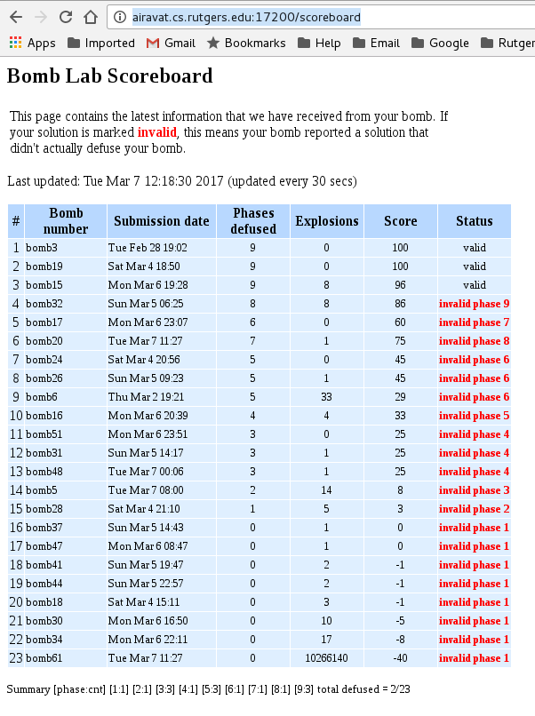
PA 3 –
Scoreboard
Remember : You will lose 0.5 points for each explodes!

Slide 5
How to Defuse It!
One way to do it by debugging using GDB
$ gdb bomb (run in gdb)
Set break point for each phase (e.g. (gdb) break phase_1) (this will help you not to explode the bomb)
Run the program ( (gdb) run)
Useful Commands for binary bomb
Print bomb’s symbol table ($ objdump -t bomb)
Disassemble the code ($ objdump -d bomb)
Display printable strings ($ strings -t x bomb)
You can save output of commands into file
Example : $ objdump -d bomb > bomb-assembly.txt

Slide 6
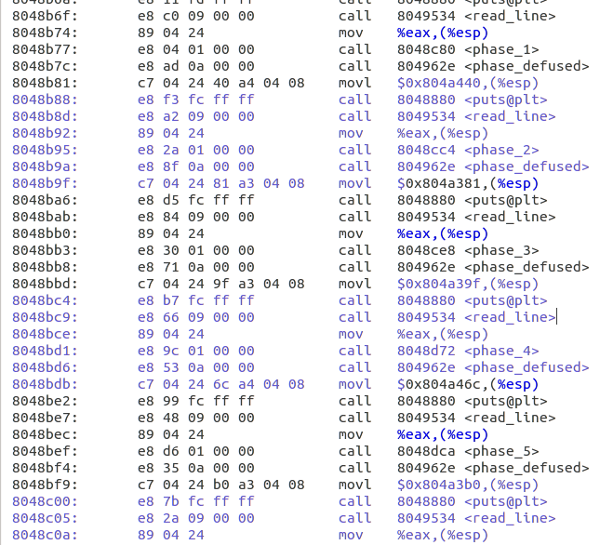
How to Defuse It!

Slide 7
Some Useful GDB Commands
(gdb) ni - next instruction
(gdb) si - step in (e.g. step into function)
(gdb) step - step out
(gdb) disas - disassemble instructions
(gdb) until *addr – jump to the given addr
(gdb) i r – print all reg values
(gdb) x/s addr – print value of the addr (similarly x/d)
GDB
https://www.csee.umbc.edu/~cpatel2/links/310/nasm/gdb_help.shtml

Slide 8
SSH Tunnel with Firefox
Linux
https://ubuntuforums.org/showthread.php?t=723025
$ ssh -D 9999 -C netId@iLab
Windows
https://www.sotechdesign.com.au/browsing-the-web-through-a-ssh-tunnel-with-firefox-and-putty-windows/

Slide 9
Assembly Language

Slide 10
Programming Meets Hardware
#include <stdio.h>
int main() {
int x, y, temp;
x=1; y=2;
temp =x; x=y; y=temp;
printf("%d %d %d\n",x,y,temp);
}
High-Level Language Program
Compiler
movl $1, -8(%ebp)
movl $2, -12(%ebp)
movl -8(%ebp), %eax
movl %eax, -16(%ebp)
movl -12(%ebp), %eax
movl %eax, -8(%ebp)
movl -16(%ebp), %eax
movl %eax, -12(%ebp)
movl -16(%ebp), %eax
movl %eax, 12(%esp)
movl -12(%ebp), %eax
movl %eax, 8(%esp)
movl -8(%ebp), %eax
movl %eax, 4(%esp)
Assembly Language Program
Assembler
ISA
Machine Language Program
7f 45 4c 46 01 01 01
00 00 00 00 00 00 00
00 00 02 00 03 00 01
00 00 00 f0 82 04 08
34 00 00 00 c4 0c 00
00 00 00 00 00 34 00

Slide 11
Assembly Programmer’s View
CPU
Memory
Control
Logic
Addresses
Registers
(OS code & data)
Object Code
Program Data
Data
Instructions
PC
ALU

Slide 12
Assembly Characteristics
Primitive Operations
Perform arithmetic function on register or memory data
Transfer data between memory and register
Load data from memory into register
Store register data into memory
Transfer control
Unconditional jumps to/from procedures
Conditional branches

Slide 13
Instruction Format
General format:
opcode operands
Opcode:
Short mnemonic for instruction’s purpose
movb,addl, etc.
Operands:
Immediate, register, or memory
Number of operands command-dependent
Example:
movl %ebx, (%ecx)

Slide 14
MOV instruction
Most common instruction is data transfer instruction
mov S, D
Copy value at S from D
Used to copy data from:
Memory to register
Register to memory
Register to register
Constant to register

Slide 15
Data Formats
Byte: 8 bits
E.g., char
Word: 16 bits (2 bytes)
E.g., short int
Double Word: 32 bits ( 4 bytes)
E.g., int, float
Quad Word: 64 bits (8 bytes)
E.g., double
Instructions can operate on any data size
movl, movw, movb
Move double word, word, byte, respectively
End character specifies what data size to be used

Slide 16
Registers
Registers are CPU components that hold data and address
Much faster to access than memory
It is used to speed up CPU operations
Categories
General registers
Data registers (Holds operands)
Pointer & index registers (Holds references to addresses as well as indices)
Control Register (e.g. CF,ZF)
Segment registers (Holds starting address of program segments)
CS, DS, SS, ES

Slide 17
Registers Overview
Named storage locations inside the CPU, optimized for speed

Slide 18
Data Registers 1
AX is the primary accumulator
Used in most arithmetic instruction
BX is the base register
Could be used in indexed addressing
CX is the count register
Store the loop count in iterative operations
DX is the data register
Used in input / output operations

Slide 19
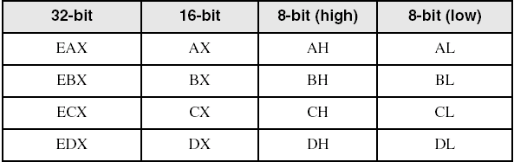
Data Registers 2
Can use 8-bit, 16-bit, or 32-bit name

Slide 20
Pointer Registers
ESP is stack pointer
It refers to be current position of data or address within the program stack
Changed by push, pop instructions
EBP is frame pointer
Referencing the parameter variables passed to a subroutine
EIP is instruction pointer
It stores the offset address of the next instruction to be executed

Slide 21
Control Registers
Overflow flag (OF)
Indicates the overflow of a high-order bit
Carry flag (CF)
Contains the carry of 0 or 1 from high-order bit after arithmetic operation
Stores the last bit of a shift or rotate operation
Sign flag (SF)
Shows the sign of the result of an arithmetic operation
Positive -> 0, Negative -> 1
Zero Flag (ZF)

Slide 22
Segment Registers
Segments are specific areas defined in a program for containing data, code, and stack
Code segment
Contains the instructions to be executed
Data segment
Contains data, constants and work areas
Stack segment
Contains data and return addresses of procedures

Slide 23
Labels
Act as place markers
Marks the address of code and data (can be used to represent an address)
Data label
Must be unique
Ex. myArray (not followed by colon)
Code label
Target of jump or loop instructions
Ex) L1: (followed by colon)

Slide 24
Immediate Addressing
Operand is immediate
Operand value is found immediately following the instruction
$ in front of immediate operand
E.g., movl $0x4040, %eax
ADDR
memory
000f
00A1
movl %eax
00A2
4040

Slide 25
Direct Addressing
Address of operand is found immediately after the instruction
Also known as direct addressing or absolute address
movl %eax, 0x0000f
0x000f
2009
2009
eax
movl eax
0000f

Slide 26
Register Mode Addressing
Use % to denote register
E.g., %eax
Source operand: use value in specified register
Destination operand: use register as destination for value
Examples:
movl %eax, %ebx
Copy content of %eax to %ebx
movl $0x4040, %eax immediate addressing
Copy 0x4040 to %eax
movl %eax, 0x0000f direct addressing
Copy content of %eax to memory location 0x0000f
<number>

Slide 27
Indirect Mode Addressing
Content of operand is an address
Designated as parenthesis around operand
Offset can be specified as immediate mode
Examples:
movl (%ebp), %eax
Copy value from memory location whose address is in ebp into eax
movl -4(%ebp), %eax
Copy value from memory location whose address is -4 away from content of ebp into eax

Slide 28
Indexed Mode Addressing
Add content of two registers to get address of operand
movl (%eab, %esi), %eax
Copy value at (address = eab + esi) into eax
Useful for dealing with arrays
If you need to walk through the elements of an array
Use one register to hold base address, one to hold index
E.g., implement C array access in a for loop
<number>

Slide 29
Thanks!
Any questions?
Notes:
<number>

